Slide 1



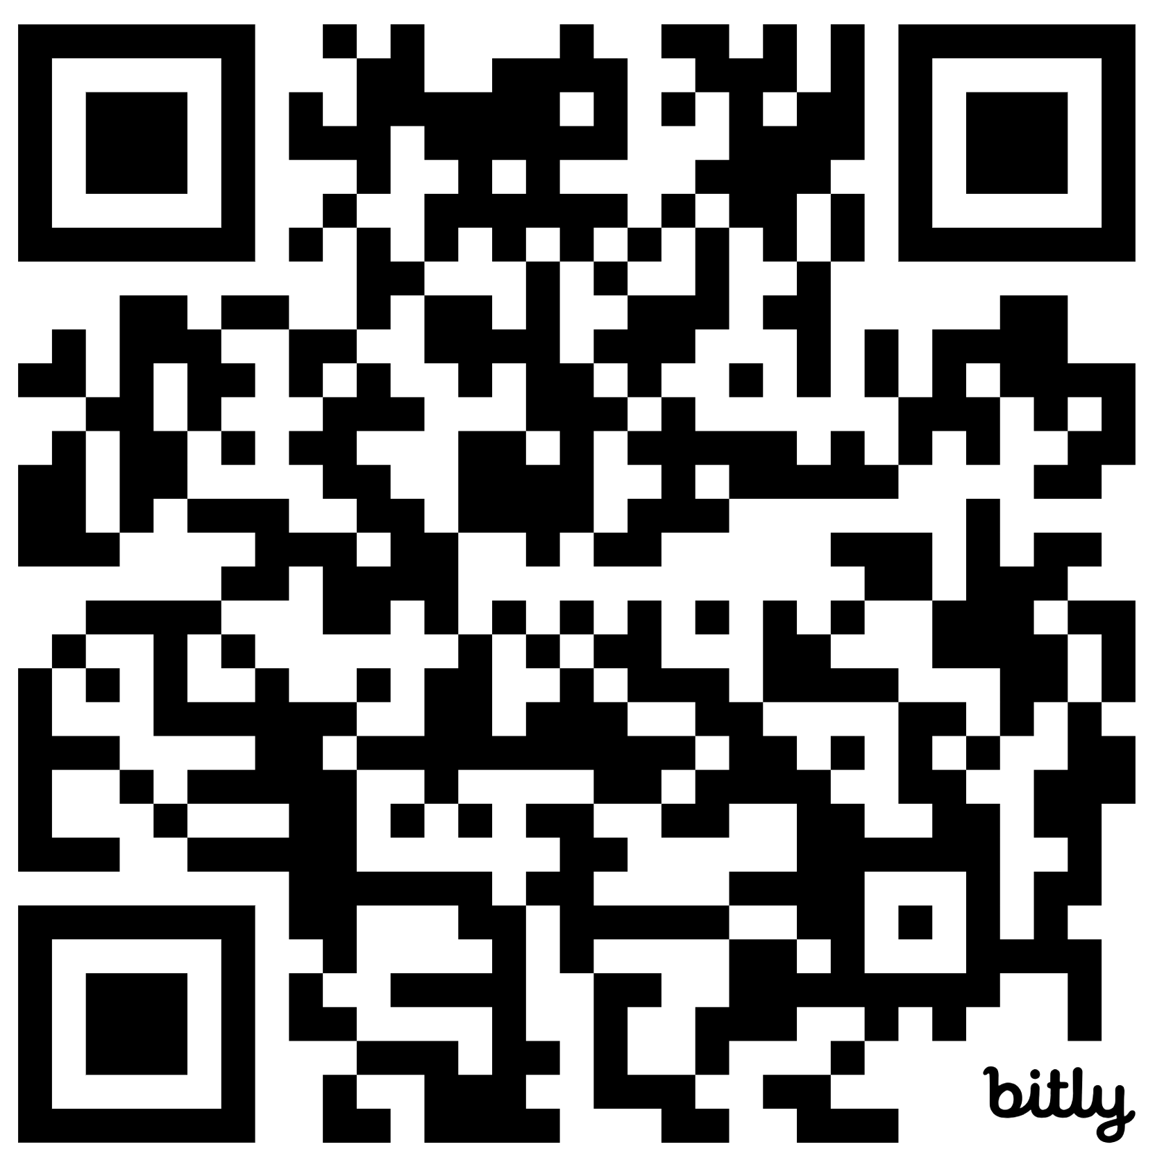
CARIBOO-CHILCOTIN SCHOOL DISTRICT PLAN FOR STUDENT SUCCESS 2024-2027 YEAR 3 • 2026-2027
Intellectual
Human & Social
Career
ENHANCED
STUDENT SUCCESS
▪ On-Track in LITERACY
▪ On-Track in Numeracy
▪ Feel Welcome, Safe,
Connected to School
▪ Graduate
▪ Core Competencies for Life Goals
STUDENTS WE ARE PAYING PARTICULAR ATTENTION TO FOR EQUITY OF OUTCOMES
● Indigenous
students
living on
reserve
● Indigenous
students living
off reserve
● Children &
youth in care
● Students with
disabilities or
diverse
abilities
▪Gr 4 & 7 FSA Reading, Writing, Numeracy
▪Gr 10 & 12 Literacy Assessment
▪Gr 10 Numeracy Assessment
▪Gr to Gr Transitions
▪Gr 4, 7, 10 Student Learning Survey:
Safe, Welcome, Sense of Belonging
▪Gr 4, 7, 10 Student Learning Survey:
Number of adults who care
▪5 Year Graduation Rate
▪Post-Secondary Transition Rate to BC
Institutions
MEASURE & MONITOR
• Report cards (On Track in Language Arts, Math, Attendance) • District Student Learning Reflection • Reading, Writing Assessments
SCHOOL AND DEPARTMENT WORKPLANS – Objectives and Key Results (OKR)
In Cariboo-Chilcotin School District we are
● Developing collective capacity in our key focus areas, for growth,
● For improved practices,
● So learners have better experiences and service,
● Leading to greater success for ALL students.
School Plans For Learner Success Virtual Tool
Data Warehouse & Information Management System
Board Policy Review
Indigenous Education Council Collaboration
ACTION:
EFFECTIVE STRUCTURES, PROCESSES, & PRACTICES
District Literacy and Numeracy Assessments
Anti-Racism & Anti-Indigenous Racism Plans
Accessibility Plan
Long Term Capital Plan and Transportation Optimization
Attendance Campaign
Alternate & Youth Community Connections Program Development
Internal and External Communications Focus
Building Security and Communications Upgrade
First Nations and MCFD Secure Data Sharing
Staff Recruitment Plan
Staff Attendance Support Program
Cybersecurity Program
Safe Schools Learning: Staff, Students, Families
District Mental Health Plan
Outdoor Learning Support Partnerships: Local, BC, National
Health & Safety Program Update
ACTION:
CAPACITY
BUILDING
Learning Series with CCTA: Aligned with Plan Priorities
PVP Mentorship and coaching
Leadership Development Program
Our Collective Responsibility Initiative
New Teacher and LOP Support Program with CCTA
Helping Teacher Model: Aligned with Learning Series, Assessments
Restorative & Trauma-informed Practice, & Circle of Courage Training
Compassionate Systems Leadership Learning Team
KEY GROWTH
AREAS
COLLECTIVE RESPONSIBILITY
INSTRUCTIONAL
CAPACITY
SAFE, CARING & INCLUSIVE LEARNING COMMUNITIES
INDIGENOUS LEARNING
& CULTURE
PLACE-BASED
LEARNING
STRATEGIC ALLOCATION of BUDGET, STAFFING, ATTENTION, and TIME to SUPPORT PLAN PRIORITIES
Notes:
Actions are draft and may be changed and/or added to

